Slide 1

FILESTREAM and FileTables
Presented by Steve Stedman

Slide 2
Presenter: Steve Stedman
FILESTREAM and FileTables
Been using SQL Server since 1990
DBA/Consultant/Trainer/Speaker/Writer
Taught SQL Server classes at WWU
SQL Server consultant
Blog regularly on SQL Server topics at http://SteveStedman.com
Author of the only book on Common Table Expressions
Founder of Database Health Monitoring
http://DatabaseHealth.com
Working at Emergency Reporting
Volunteer Firefighter and EMT
http://SteveStedman.com for more information.

Slide 3
Outline
FILESTREAM and FileTables
FILESTREAM – SQL Server 2008 and newer
Introduction and Configuration
Creating a Table Using FILESTREAM
TSQL FILESTREAM Access
FileTables – SQL Server 2012 and newer
Configuring and Creating FileTables
Insert, Update and Delete with a FileTable
Drag and drop with the file system

Slide 4


FILESTREAM
FILESTREAM and FileTables
SQL Server
Notes:
Vivid: Several years ago, I was hired to work on a database to help improve performance. This database had some of the typical performance tuning issues that needed to be addressed, but as I looked into it in more detail I discovered that for a 90gb database, 80gb was used up by one table. Looking further into that table, there was one column of type varbinary that was being used to hold files. After some re-architecting the software that was using the database to store files, I was able to convince the developers that there was a really great system to store files, it is called a file system. What helped convince them of this was the projected costs to upgrade the SQL Server hardware and licensing over the next 3 to 5 years to accommodate these files. It became very clear that at that point in time the file system was the best system to store files.

Slide 5
FILESTREAM and VARBINARY(MAX)
FILESTREAM and FileTables
SQL Server
Notes:
That was then, and times change. Microsoft added new features to SQL Server 2008 called FileStream that is still an important part of SQL Server 2012.
FileStream allows for a VARBINARY(MAX) column to be set to write to a location on disk rather than to the traditional storage location in the SQL Server Database.

Slide 6
Move BLOBs Out Of The Database
FILESTREAM and FileTables
SQL Server
Access them like they
are in the database
Notes:
By using FILESTREAM for large BLOB (Binary Large Objects) data such as varbinary(max) and varchar(max) can be moved from the database to the filesystem allowing for better performance and smaller database files. Imagine a table with 30gb of varbinary(max), without filestream all of that varbinary data might end up in memory cluttering the buffer pool and pushing other data out of memory.
With FILESTREAM you have most the ease of accessing data as thought it was just stored in a column, but you get the performance of saving the files to disk.
Additionally when a backup is run the filestream files are included in the SQL Server backup.

Slide 7
Why FILESTREAM
FILESTREAM and FileTables
FILESTREAM for large VARBINARY, VARCHAR, or NVARCHAR columns can increase performance over the same table without FILESTREAM since the FILESTREAM data does not clutter the buffer pool, thus leaving room for other tables in memory.
Data stored on disk using FILESTREAM is included in the database backup.

Slide 8
Three Ways To Enable FILESTREAM
FILESTREAM and FileTables
During SQL Server Installation
SQL Server Configuration Manager
Sp_configure
NOTE: FILESTREAM is enabled on an instance level, not a database level.

Slide 9
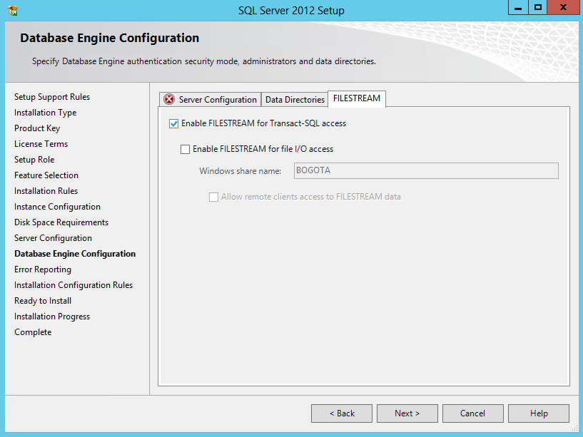
FILESTREAM during SQL Server Installation
FILESTREAM and FileTables

Slide 10
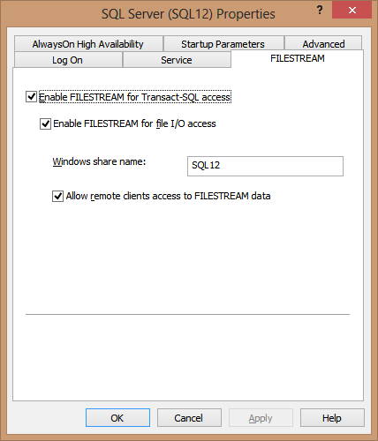
SQL Server Configuration Manager
Enable in the Configuration Manager
Be sure to restart the SQL Server Instance after configuring

Slide 11
With Sp_configure
There are three levels that can be set with sp_configure for FILESTREAM
0 : FILESTREAM support for the instance is Disabled
1 : FILESTREAM for T-SQL Access is Enabled
2 : FILESTREAM for T-SQL and Windows streaming access is Enabled

Slide 12
Sp_configure Syntax
FILESTREAM and FileTables
USE [FilestreamDemoDB];
-- First check the level
EXEC sp_configure filestream_access_level
-- then set it as needed
EXEC sp_configure filestream_access_level, 1;
-- don't forget to run RECONFIGURE
RECONFIGURE;

Slide 13
Enable FILESTREAM on The Database
FILESTREAM and FileTables
CREATE DATABASE [FilestreamDemoDB];
ALTER DATABASE FilestreamDemoDB
ADD FILEGROUP fsGroup CONTAINS FILESTREAM;
GO
-- Be sure the C:\Filestream directory exists on your SQL Server
ALTER DATABASE FilestreamDemoDB
ADD FILE( NAME = 'fsFilestreamDemoDB',
FILENAME = 'C:\FileStream\FilestreamDemoDB')
TO FILEGROUP fsGroup;

Slide 14
FILESTREAM Notes
FILESTREAM and FileTables
There is a 2gb limit on VARBINARY(MAX) when used without FILESTREAM. When using FILESTREAM there is no longer a limit in place.
If you are using log shipping, the files stored using FILESTREAM will be sent to the log shipping server.
A database can be configured to use FILESTREAM when the database is created, or later using the ALTER DATABASE command to add FILESTREAM.

Slide 15
FILESTREAM Limitations
FILESTREAM and FileTables
The T-SQL .WRITE functionality doesn’t work on FILESTREAM tables
Mirrored databases do not support FILESTREAM

Slide 16
Demo
FILESTREAM and FileTables
FILESTREAM Configuration

Slide 17
Creating a Table Using FILESTREAM
FILESTREAM and FileTables
Table:
Must have a Non Null Unique Column with the ROWGUIDCOL property
Used to uniquely identify each file saved into the file system.

Slide 18
Creating a Table Using FILESTREAM
FILESTREAM and FileTables
CREATE TABLE [dbo].[FileStreamFiles]
(
[id] UNIQUEIDENTIFIER ROWGUIDCOL NOT NULL UNIQUE,
[description] VARCHAR(30),
[fileData] VARBINARY(MAX) FILESTREAM NULL
);

Slide 19
Demo
FILESTREAM and FileTables
Creating a Table Using FILESTREAM

Slide 20
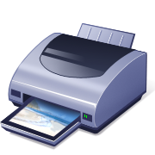
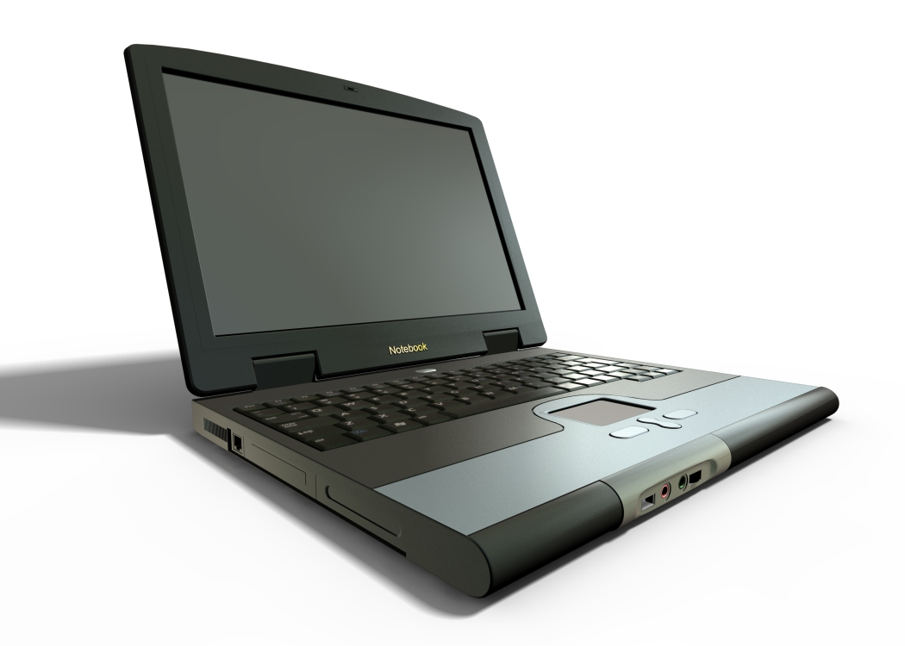
TSQL FILESTREAM Access
FILESTREAM and FileTables
Notes:
VIVID: Assume that you just purchased a new printer for your computer, you bring it home and attempt to make it work, but you don’t have the right cables, and it is not a wifi printer. There is no way to print without getting the right cables to connect the printer to your database. You then go back to the store, purchase the right cables, and you are ready to start printing.
Filestream is similar, if you enable your database for filestream, and create a filestream table, you now need the right tools to connect and use that filestream table. Just like how you can print if you have all the right connections, you can use filestream if you have the right query knowledge.

Slide 21
TSQL FILESTREAM Access
FILESTREAM and FileTables
Database
Database Filestream Files

Slide 22
INSERT to FILESTREAM
FILESTREAM and FileTables
Insert data like it is a VARBINARY or VARCHAR column
Data is saved to disk outside of the SQL Server Data File

Slide 23
TSQL FILESTREAM Access - INSERT
FILESTREAM and FileTables
INSERT INTO [dbo].[FileStreamFiles]
([id], [description], [fileData])
VALUES
(NEWID(), 'Test File', CAST('testdata' AS VARBINARY(MAX)));

Slide 24
SELECT From a FILESTREAM Table
FILESTREAM and FileTables
Selecting form a FILESTREAM table streams the data from disk without cluttering up the buffer pool
Select is done just like selecting VARBINARY or VARCHAR data

Slide 25
TSQL FILESTREAM Access - SELECT
FILESTREAM and FileTables
SELECT CAST ([fileData] AS VARCHAR(MAX))
FROM [dbo].[FileStreamFiles];

Slide 26
Demo
FILESTREAM and FileTables
TSQL FILESTREAM Access
Finding the FILESTREAM files on your hard drive

Slide 27
Next…
FILESTREAM and FileTables
FileTable: everything that FILESTREAM should be, and more.

Slide 28






FileTables
FILESTREAM and FileTables
Notes:
Vivid: Assume that you have thousands of pictures that you have taken with your digital camera of the last decade. In this case you may have them organized in any number of directories based on dates, or topics, or some other structure. You probably don’t have a way to tag or label those pictures with anything besides the filename that the digital camera assigned them, or maybe you gave them each a descriptive name to replace the default camera name. If you could organize these in a database you could assign all types of useful information to them like the names of the people in the picture, or the location they were taken.
To achieve this task you may want to store the filenames in the database and then add columns to a table to describe the details associated with those filenames.

Slide 29
Introducing FileTable
FILESTREAM and FileTables
SQL Server
Notes:
FileTables are a database hierarchy attached to all the files in a given directory in your filesystem, allowing standard file system access to all of those files with their existing filenames. Filetable can give you that association from the filesystem structure to a relational database model. When you insert to a filetable it creates the files on disk, and when you add files to the directory on disk it is equivalent to inserting to the table.

Slide 30
FileTable Compared To FILESTREAM
FILESTREAM and FileTables
FileTable
FileStream
Directory structure configurable.
FileTable has fixed columns.
Windows API compatible allows direct file access from most applications.
Directory structure configured by SQL server using UNIQUEIDENTIFIER.
You control the columns.
Requires specific programming to access files directly.

Slide 31
Configuring Your Database
FILESTREAM and FileTables
Configuration similar to FILESTREAM access
Need to turn on NON_TRANSACTED_ACCESS
Allows access from outside of T-SQL
Drag and drop instead of INSERT

Slide 32
Configuring Your Database
FILESTREAM and FileTables
ALTER DATABASE FilestreamDemoDB
ADD FILEGROUP fsGroup CONTAINS FILESTREAM;
GO
-- Be sure the C:\Filestream directory exists on your SQL Server
ALTER DATABASE FilestreamDemoDB
ADD FILE( NAME = 'fsFilestreamDemoDB',
FILENAME = 'C:\FileStream\FilestreamDemoDB')
TO FILEGROUP fsGroup;
-- Turn on NON_TRANSACTED_ACCESS
ALTER DATABASE FilestreamDemoDB
SET FILESTREAM ( NON_TRANSACTED_ACCESS = FULL,
DIRECTORY_NAME = N'FilestreamDemoDB' );

Slide 33
Creating a FileTable
FILESTREAM and FileTables
Use CREATE TABLE syntax without specifying any columns
Include the WITH (FILETABLE_DIRECTORY parameter
CREATE TABLE PictureFiles as FileTable
WITH (FILETABLE_DIRECTORY = 'PictureFiles');

Slide 34
Demo
FILESTREAM and FileTables
Configuring FileTable, and creating a FileTable

Slide 35
FileTable Notes
FILESTREAM and FileTables
Backup and restore of your database include FileTable data.
FileTables rely on FILESTREAM functionality. You must enable FILESTREAM to be able to use FileTables.
You can find files in the FileTable by using the Explore FileTable Directory when right clicking on the filetable name in the SQL Server Management Studio Object Explorer.

Slide 36
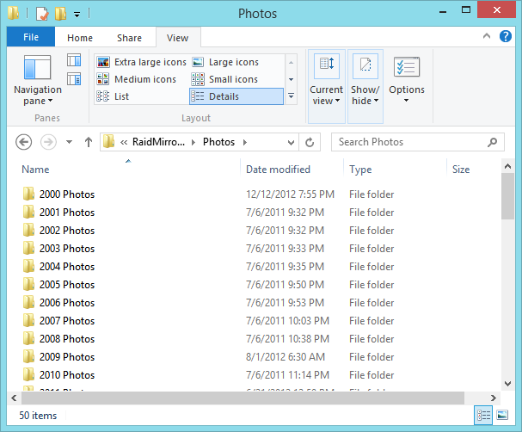
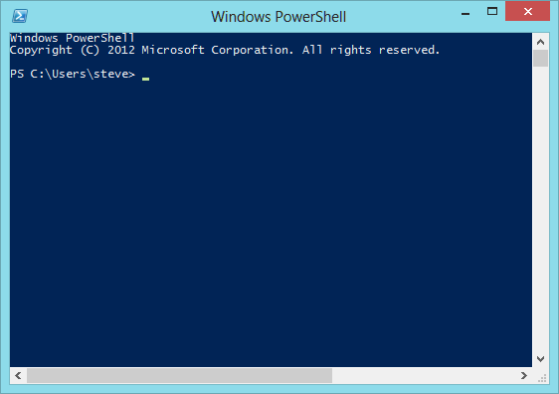
INSERT, UPDATE and DELELE
FILESTREAM and FileTables
Use TSQL
Or use the Windows File System

Slide 37
Demo
FILESTREAM and FileTables
Inserting to a filetable with drag and drop

Slide 38
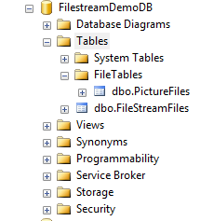
Locating Existing FileTables
3 Ways To Locate Existing FileTables
From your database in the Object Explorer, expanding Tables, then expanding the FileTables list.
Runing the query: SELECT * FROM sys.filetables;
Runing the query: SELECT * FROM sys.tables WHERE is_filetable = 1;

Slide 39
Demo
FILESTREAM and FileTables
Locating Filetables

Slide 40
FileTable Notes
FILESTREAM and FileTables
Insert, update and deletes are allowed for FileTables.
You can do insert, update and delete from T-SQL or from the file system.
The easiest way to insert to a FileTable may be to just drag files into the FileTable directory.
Rolling back a transaction also rolls back the files on the file system.
Files in the FileTable use the same security attributes as other SQL tables or data. If you don’t have permissions to get at a file through T-SQL you won’t be able to access it through the file system.

Slide 41
Summary
FILESTREAM and FileTables
FILESTREAM
Introduction and Configuration
Creating a Table Using FILESTREAM
TSQL FILESTREAM Access
FileTables
Configuring and Creating FileTables
Insert, Update and Delete with a FileTable
Drag and drop with the file system

Slide 42
“Next Steps” for Attendees
Determine if your SQL Server is configured for FILESTREAM access
On a test database enable FILESTREAM
Create FileTable on a test database and insert some files

Slide 43
Resources for Attendees
SQL Server Performance for Developers
Follow me on Twitter
@SqlEmt
Visit my website
http://stevestedman.com/
Send me an email:
Steve@SteveStedman.com

Slide 44
Related Session(s)
SQL Server Performance for Developers – Tomorrow morning in this room

Slide 46
FILESTREAM and FileTables Quiz

Slide 47
1. Enabling FILESTREAM
There are three ways to enable FILESTREAM for a SQL Server instance. Which of the following in not one of the three?
Using the sp_configure stored procedure
Using the sp_enableFILESTREAM stored procedure
From the SQL Server installation
From the SQL Server Configuration Manager

Slide 48
1. Enabling FILESTREAM
There are three ways to enable FILESTREAM for a SQL Server instance. Which of the following in not one of the three?
Using the sp_configure stored procedure
Using the sp_enableFILESTREAM stored procedure
From the SQL Server installation
From the SQL Server Configuration Manager
sp_enableFILESTREAM stored procedure does not exist.

Slide 49
2. FILESTREAM Data Types
Which SQL data types can utilize FILESTREAM? (Choose one or multiple)
TEXT
VARBINARY(MAX)
VARCHAR(MAX)
INTEGER

Slide 50
2. FILESTREAM Data Types
Which SQL data types can utilize FILESTREAM? (Choose one or multiple)
TEXT
VARBINARY(MAX)
VARCHAR(MAX)
INTEGER
TEXT and INTEGER data types are not supported as filestream columns.

Slide 51
3. FILESTREAM storage
Data using stored with FILESTREAM is stored where?
On a tape drive.
In RAM only.
In SQL Server, but not in the buffer pool.
In the file system, outside of the SQL Server Instance.

Slide 52
3. FILESTREAM storage
Data using stored with FILESTREAM is stored where?
On a tape drive.
In RAM only.
In SQL Server, but not in the buffer pool.
In the file system, outside of the SQL Server Instance.
FILESTREAM data is stored in the file system outside of the SQL instance data.

Slide 53
4. T-SQL for FILESTREAM Access
T-SQL for accessing FILESTREAM VARBINARY(MAX) data differs from accessing non-FILESTREAM VARBINARY(MAX) data in which way?
They are similar but the difference is in the size limitation, non FILESTREAM is limited to 2GB, but FILESTREAM data does not have this limit.
They are the identical.
They are similar but the difference is in the size limitation, non FILESTREAM is limited to 1GB, but FILESTREAM data does not have this limit.

Slide 54
4. T-SQL for FILESTREAM Access
T-SQL for accessing FILESTREAM VARBINARY(MAX) data differs from accessing non-FILESTREAM VARBINARY(MAX) data in which way?
They are similar but the difference is in the size limitation, non FILESTREAM is limited to 2GB, but FILESTREAM data does not have this limit.
They are the identical.
They are similar but the difference is in the size limitation, non FILESTREAM is limited to 1GB, but FILESTREAM data does not have this limit.

Slide 55
5. DROP FileTable
When you use the DROP TABLE command on a FileTable, what happens to the files on disk?
They are moved to a lost and found directory to be claimed later.
They are left in place as DROP TABLE only removes the FILETABLE in the database.
They are backed up then deleted.
They are deleted.

Slide 56
5. DROP FileTable
When you use the DROP TABLE command on a FileTable, what happens to the files on disk?
They are moved to a lost and found directory to be claimed later.
They are left in place as DROP TABLE only removes the FILETABLE in the database.
They are backed up then deleted.
They are deleted.

Slide 57
6. Finding FileTables
Which of the following will not give you a list of the FileTables in your database?
From your database in the Object Explorer, expanding Tables, then expanding the FileTables list.
Right clicking on the database in the Object Explorer and selecting List FileTables.
Runing the query: SELECT * FROM sys.filetables;
Runing the query: SELECT * FROM sys.tables WHERE is_filetable = 1;

Slide 58
7. SQL Server Version for FileTable
FileTable was introduced in which version of SQL Server?
2005
2008
2008R2
2012

Slide 59
7. SQL Server Version for FileTable
FileTable was introduced in which version of SQL Server?
2005
2008
2008R2
2012
FileTable was a new feature added in to SQL Server 2012. FILESTREAM existed prior to SQL 2012, but not FileTable.

Slide 60
Resources for Attendees
SQL Server Performance for Developers
Follow me on Twitter
@SqlEmt
Visit my website
http://stevestedman.com/
Send me an email:
Steve@SteveStedman.com

